Slide 1


SAP UI5 & FIORI with OData TRAINING
Anubhav Oberoy
Day – 7

Slide 2

Agenda – Day 7
Concept of Base Controller
XML Model
Resource model in UI5
Multi-Language Support of the App
Formatter in UI5
User Experience and User Interface
Introduction to Fiori
Structure of a fiori Project

Slide 3
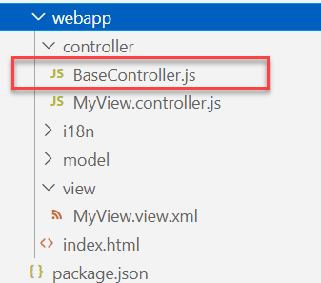
Concept of Base Controller in UI5
Base Controller:- A base controller is a controller with basic functionalities from which the other controllers in your SAPUI5 application inherit.
The base controller holds basic functionalities that are used across multiple controllers.
The base controller itself is just another JavaScript file and it does not have the .controller prefix. Just BaseController.js and not BaseController.controller.js.
The base controller goes in the controller folder in your SAPUI5 application folder structure:
sap/ui/core/mvc/Controller
x
BaseController
Template
x
Controller 1
x
Controller 2
x
Controller 3
x
Controller 4
View 1
View 2
View 3
View 4

Slide 4

Exercise: Base Controller
In this exercise we will create a new BaseController.
Along with that we will see how to load data to a model from a file.
Exercise code/resources: -
MyView.view.xml
MyView.controller.js
BaseController.js

Slide 5
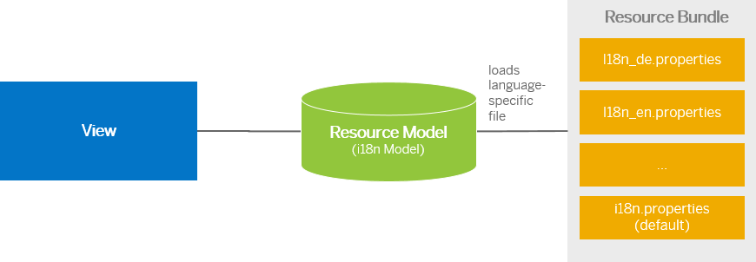
Resource Model
We build software for international audience, we cannot just hardcode every screen element in English, if it requires multi-lingual support, we need to add resource model.
i18n → Internationalization
Create resource bundle which includes label field
The name of the file must be i18n.properties for default labels
And i18n_langcode.properties for different languages
Set The model
For more information about i18n you check the link
https://openui5.hana.ondemand.com/1.34.9/docs/guide/831039835e7c4da3a8a0b49567573afe.html
We can change the language of the app by adding ?sap-language=language_code at the end of the URL of the app. Example for Hindi we will write ?sap-language=hi

Slide 6

Exercise: Resource Model
In this exercise we will see how the language of an app is changed using the i18n file.
We have to create a folder ‘i18n’ in webapps folder and in the folder, we have to add files named ‘i18n.properties’ and one another file named according to the language we want. For example:- for Hindi language the file is named as ‘i18n_hi.properties.
Along with that we will add a delete button on top of the table to delete the record of an employee from the model.
Exercise Code:-
MyView.view.xml
MyView.controller.js
i18n.properties
i18n_hi.properties

Slide 7
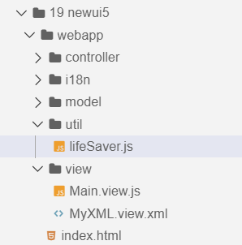
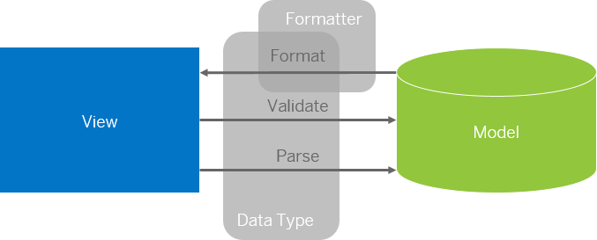
Formatter in SAP UI5
Formatters are used to define the formatting of data on the UI while data types work in both directions: they format the data on the UI and parse and validate user input that is entered.
Formatter is a function; This function gets called JUST Before the binding takes place with the view.
Formatter file is placed in a folder in webapp folder, and the file can be named anything with the .js extension.
Formatter

Slide 8

Exercise: Formatter
In this exercise we are going to currency code in the table.
We will convert the currency code into its corresponding currency symbol.
We will achieve this by using a formatter function.
Exercise Code:-
MyView.view.xml
MyView.controller.js
lifeSaver.js

Slide 9
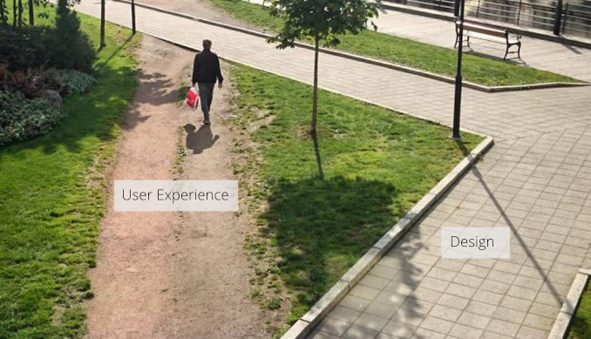
User Experience v/s User Interface
User interface is developer oriented. This is purely technical. We can change UI any number of times.
User experience is user oriented. It is psychological. We cannot change UX.

Slide 10
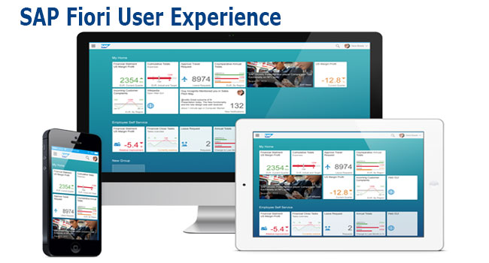
What is Fiori?
SAP Fiori is the user interface or user experience (UX) that supplements and can replace the SAP GUI. This streamlined application uses tiles to encapsulate standard tasks, such as approving purchase requisitions, viewing sales orders, and approving timesheets.
Fiori is SAP’s new user experience. These are standard apps delivered by SAP and by following the Development guidelines any one can use UI5 to create Fiori Apps.
Fiori is a streamlined application, delivering a role-based user experience that can be personalized across all lines of business, tasks and devices.
It uses tiles to encapsulate standard tasks like viewing sales orders or approving timesheets.
Fiori = UI5 + Development/Design Guidelines

Slide 11
Structure of a Fiori project
There are different folders and directory are required for setup project: webapp, Controller, models, utils ,view, Component.js, manifest.json, index.html
Structure of normal ui5 application
Index.html
View
Controller
Structure of Fiori Application
Dev.
sap/ui/core/UIComponent
Index.html
Root View
App.view.xml
Component.js
View 1
Controller 1
Container
App (pages)
View 2
Controller 2
manifest.json
App descriptor
App.controller.js
BaseController
Component.js is starting point

Slide 12
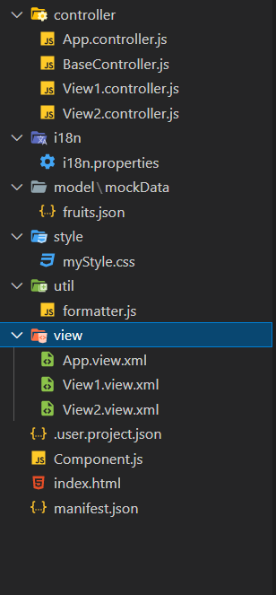
Structure of Fiori Project Files
There are different folders and directory are required for setup project
Webapp = This provides the root directory and of all files given in alias name or namespace
Controller = The controller folder contains all the controllers used by your views and might also contain additional logic files that are used by one or more controllers. The structure of the controller folder should mirror the view folder.
models = It contains .json file and object of data
utils = It is the reuse file of JS code
view = It contains all the .xml files.
Component.js = It is the starting file of our app
manifest.json = It is the application descriptor file.
Index.html

Slide 13

End of Day 7

Slide 14

Questions

Slide 15

Anubhav Oberoy

Slide 16


We’re committed to empower you to be
Most Desirable Resource
through powerful training solutions.
We build the workforce of the future.
250+
Corporate Clients
30,000+
Learners Trained
25000+
Learners Placed
FREE WEBINARS
Sign up for free webinars with industry experts every fortnight!
Enroll Now!
Contact us today!
https://anubhavtrainings.com/

Slide 17




More from AnubhavTrainings.com

Slide 18
Title
Content

